Slide 1
Financial Transaction Fraud Detection Analysis
Jahnavi Chintakindi
Data Visualization Term Project
December 11, 2024
Notes:
Hi, my name is [Your Name]. Today I'll be presenting my data visualization project on Financial Transaction Fraud Detection Analysis using the PaySim dataset.

Slide 2
Research Questions & Motivation
What did we investigate?
Patterns in financial transaction fraud
Three key questions:
Do fraudulent transactions have distinct amount patterns?
Which transaction types are more fraud-prone?
Is there a temporal pattern to fraud?
Why this matters?
Growing digital economy concerns
Billions lost to financial fraud annually
Critical for financial security
Notes:
In this project, I focused on investigating three main questions about financial fraud patterns. First, do fraudulent transactions show different patterns in their amounts? Second, are certain types of transactions more likely to involve fraud? And third, is there a time-of-day pattern to fraudulent activities? I chose this topic because financial fraud is a growing concern in our digital economy, with billions lost annually to fraudulent transactions.

Slide 3
Dataset & Preprocessing
Data Source
PaySim synthetic financial dataset (Kaggle)
Simulates mobile money transactions
Based on real-world patterns
Preprocessing Steps
Hour extraction from 'step' column (step % 24)
Fraud rate calculations
Balance difference derivation
Transaction type standardization
Data consistency verification
Notes:
For my analysis, I used the PaySim dataset from Kaggle. This is a synthetic dataset that simulates mobile money transactions based on real-world patterns. To prepare the data for analysis, I performed several preprocessing steps including extracting hour information from the step column, calculating fraud rates, and standardizing transaction types. This preprocessing was essential for meaningful visualization and analysis.

Slide 4
Visualization 1: Fraud Rate by Transaction Type

Slide 5
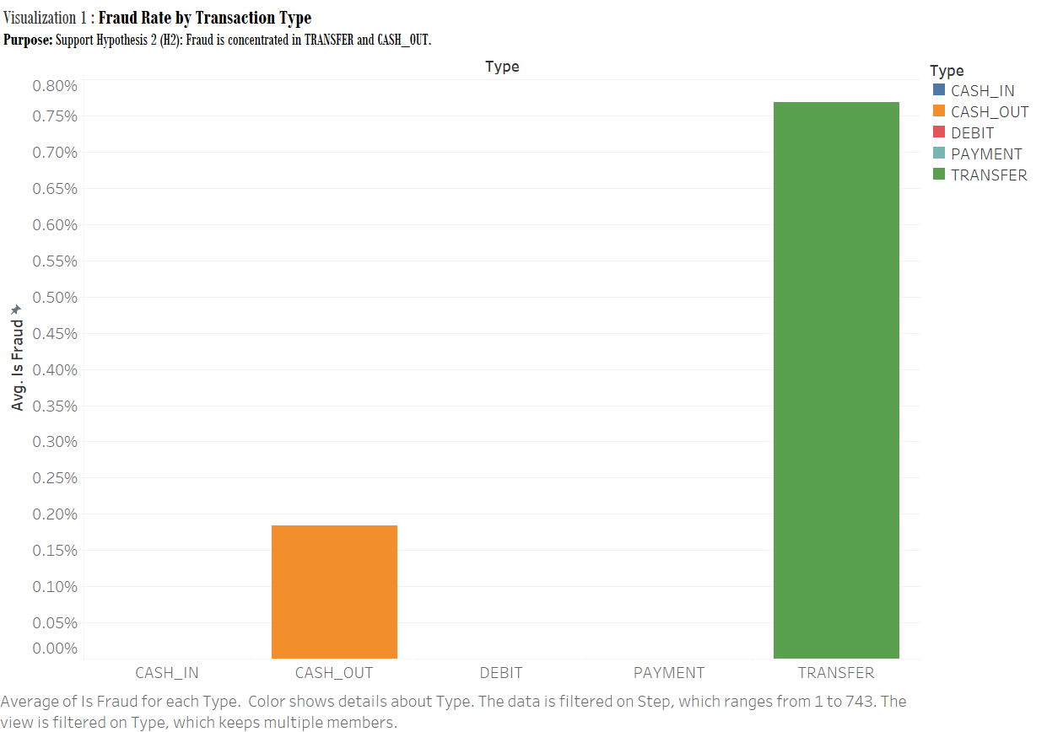
Design Choices
Bar chart for categorical comparison
Clear percentage scale
Color coding for emphasis
Key Findings
TRANSFER: Highest fraud rate (0.8%)
CASH_OUT: Second highest (0.2%)
Other types: Minimal fraud risk
Notes:
My first visualization shows fraud rates across different transaction types. I chose a bar chart format for easy comparison between categories. As you can see, TRANSFER transactions have the highest fraud rate at 0.8%, followed by CASH_OUT at 0.2%. Other transaction types show minimal fraud risk. This clearly shows that fraud is concentrated in specific transaction types

Slide 6
Visualization 2: Temporal Fraud Patterns

Slide 7
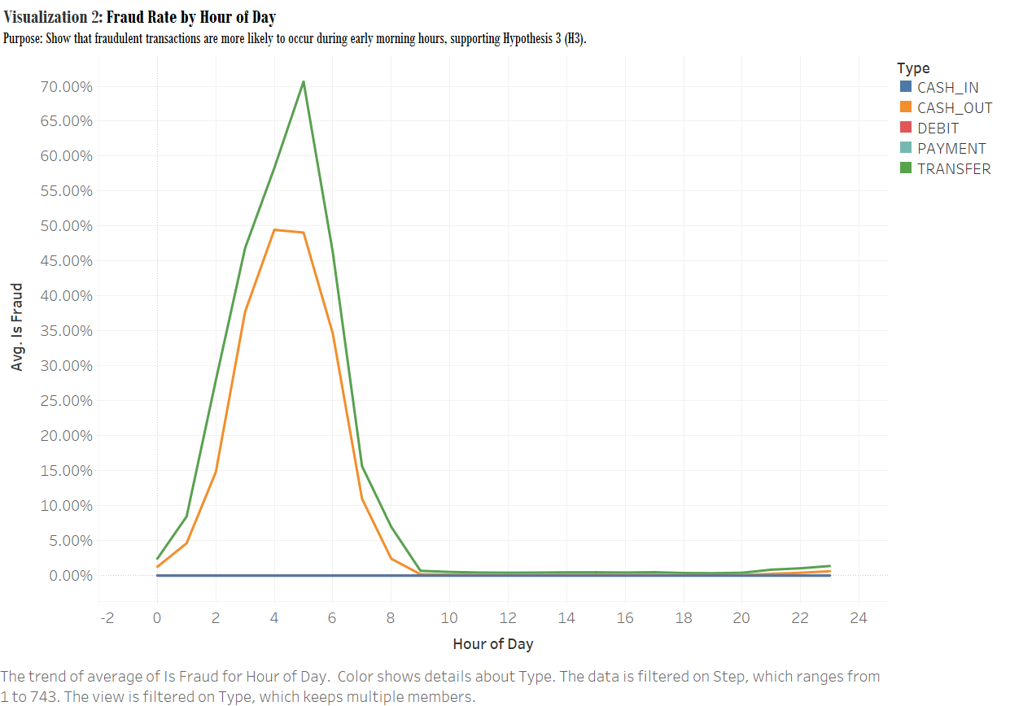
Design Choices
Line graph for temporal trends
Hour-by-hour visualization
Grid lines for reference
Key Findings
Peak fraud: 2-5 AM
Maximum rate: ~22% at 3-4 AM
Clear early morning pattern
Notes:
This line graph shows fraud rates throughout the day. What's striking is the clear peak in fraudulent activity between 2 and 5 AM, reaching about 22% around 3-4 AM. This suggests fraudsters prefer to operate during early morning hours when monitoring might be reduced.

Slide 8
Visualization 3: Transaction Amount Analysis

Slide 9
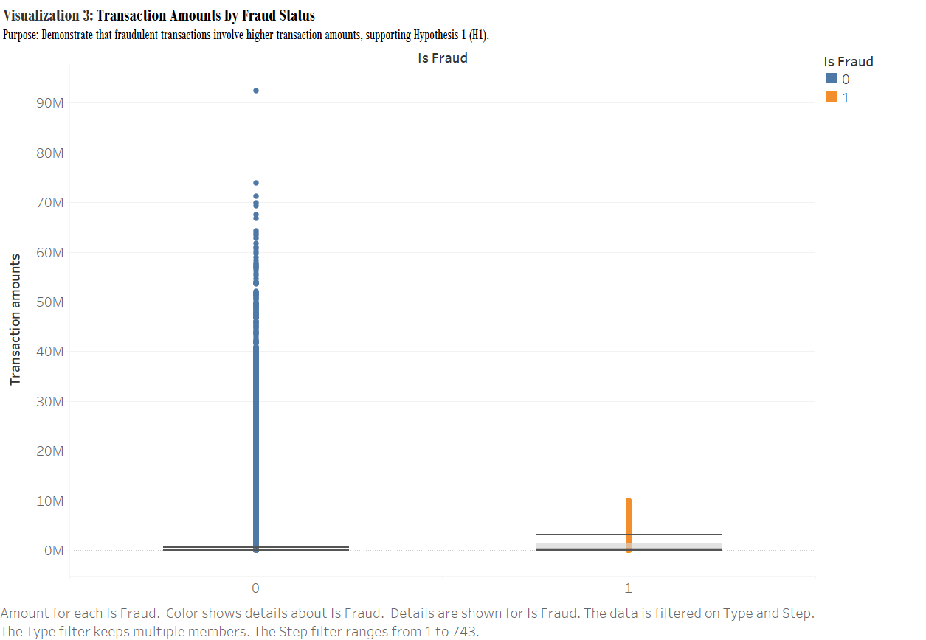
Design Choices
Box plot with log scale
Clear fraud/non-fraud comparison
Outlier visualization
Key Findings
Higher amounts in fraudulent transactions
Greater variance in fraud cases
Clear separation between legitimate and fraudulent patterns
Notes:
This box plot compares transaction amounts between fraudulent and legitimate transactions. Using a logarithmic scale helped visualize the wide range of amounts. You can see that fraudulent transactions typically involve higher amounts and show greater variance than legitimate ones

Slide 10
Learning Outcomes
Technical Insights
Power of visual analytics in pattern detection
Importance of appropriate visualization selection
Value of multiple analytical perspectives
Practical Applications
Focus areas for fraud detection:
High-value transactions
Early morning hours (2-5 AM)
TRANSFER and CASH_OUT transactions
Account balance patterns
Notes:
Through this project, I learned how different visualization techniques can reveal distinct patterns in complex data. The analysis identified four key areas for fraud detection: high-value transactions, early morning hours, specific transaction types, and unusual account balance patterns

Slide 11
Project Impact
Key Takeaways
Visual analytics crucial for complex pattern detection
Multiple visualization types needed for complete understanding
Clear patterns can inform fraud prevention strategies
Future Applications
Enhanced monitoring systems
Risk-based transaction screening
Time-based security measures
Notes:
The key takeaway from this project is that visual analytics can effectively reveal patterns in financial transaction data. These insights can be applied to enhance monitoring systems and develop better fraud prevention strategies

Slide 12
Demo:

Slide 13
Thank you

